Slide 1
Summer Internship Presentation Kristoffer Larsen May-August 2022
Notes:
‹#›

Slide 2
Overview
Background
Project Work: Water Science Group
Learning
Questions

Slide 3

My Background
Hometown: Ypsilanti, MI
Entering senior year at Michigan Tech
B.S. in Statistics
Work in Tech’s MIIL (Medical Imaging and Informatics Laboratory) under Dr. Weihua Zhou doing computer vision and medical image fusion
First time as a summer intern here at MTRI
Notes:
only work monday-thursday
‹#›

Slide 4



Project Work
IOPs “Canadian Data Analysis”
Muskegon Lake
QWIP Scores
VIIRS NRT & SQ
Toxins & Scum

Slide 5
IOPs “Canadian Data Analysis”
Objectives: Get a better representation of IOPS, such as a(phy)* and a(nap)* in the great lakes so that they can be possibly incorporated/parameterized into existing hydro-optical models
Chl = Chlorophyll A
MSPM = Mineral Suspended Particulate Matter
a(phy)* = a(Phytoplankton) / Chl
a(nap)* = a(Non-Algal Particles) / MSPM
Note: nap includes minerals and detritus (debris/waste)
Notes:
Understanding the variability in IOPs determined by the various constituents of the great lakes is a fundamental aspect in formulating useful and interpretable models

Slide 6
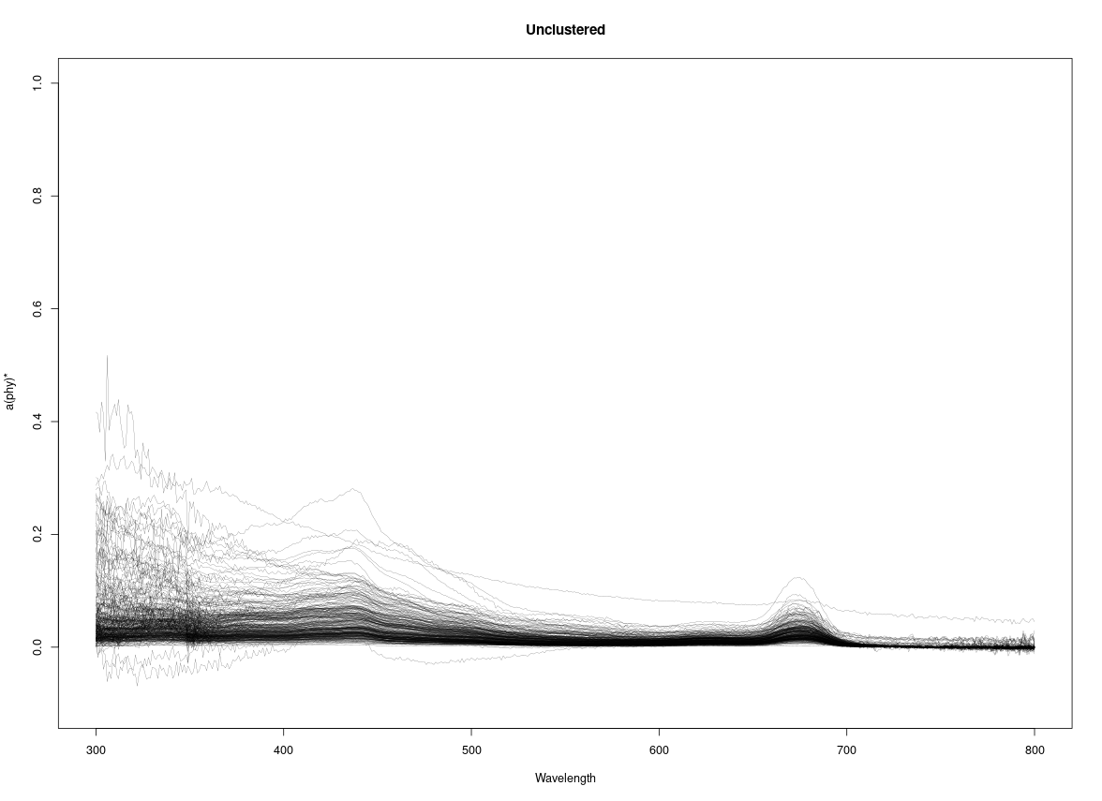
IOPs “Canadian Data Analysis”
Remove ‘scum’
Snip Ends (380-740)
Continuum Removal
PCA
FCM Clustering

Slide 7
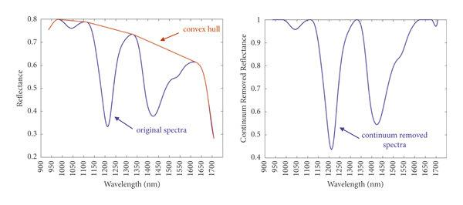
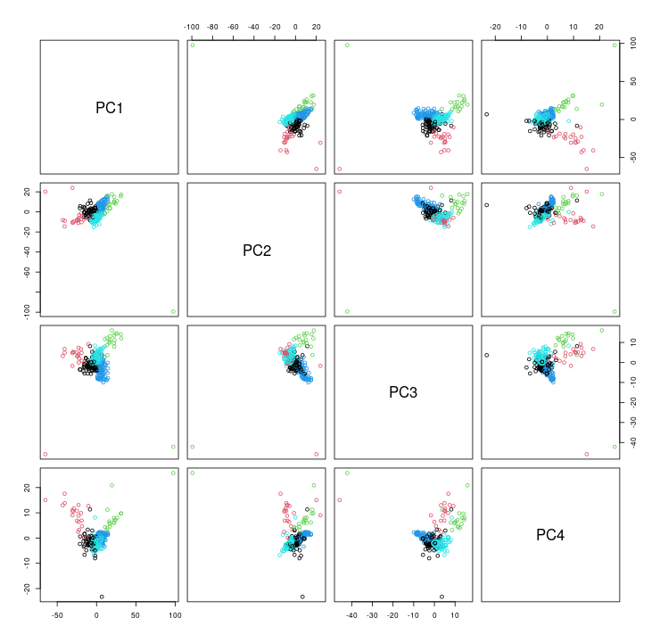
Continuum Removal & PCA
Continuum Removal:
Form Spine on Spectra Maxima
Divide or Subtract from Spectra
Highlights dips and other features
PCA:
Dimension Reduction
Easily Separates Clusters
Notes:
https://www.researchgate.net/figure/The-use-of-continuum-removal-for-quantification-of-absorption-peaks-by-connecting-the_fig5_358841599
24 PCA
Hard to undo Continuum Removal

Slide 8
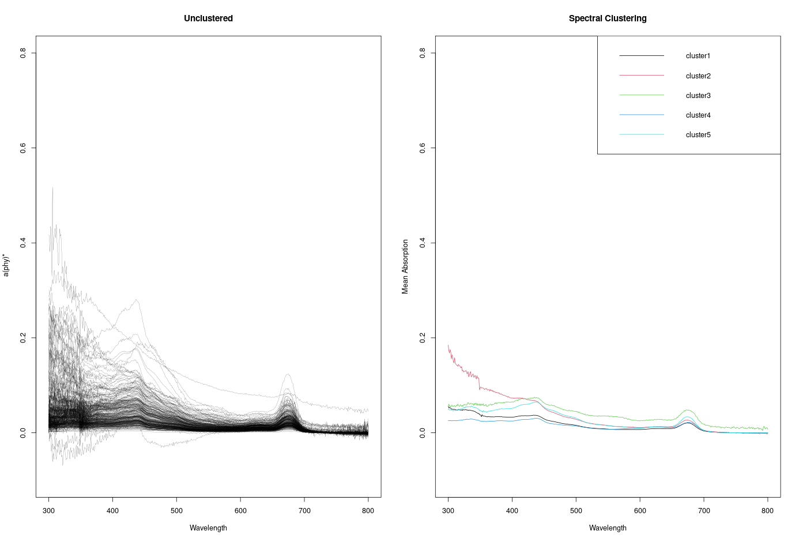
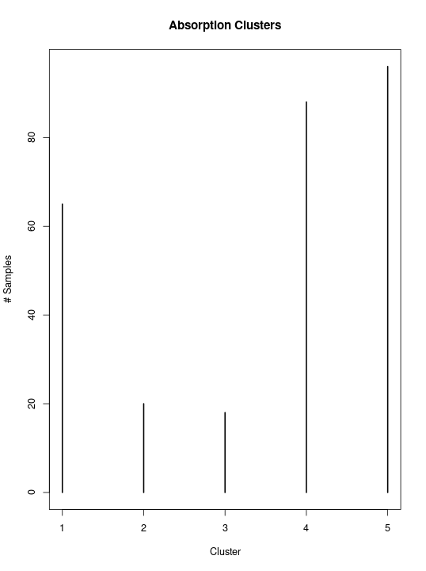
Clustering
FCM:
Useful for showing the degree of agreement of a sample to any cluster
FCM:
Form clusters by maximizing inter-cluster difference, but minimizing intra-cluster difference (Silhouette metric)
Notes:
FCM useful for looking at samples on edge cases where it almost belongs to another cluster.

Slide 9
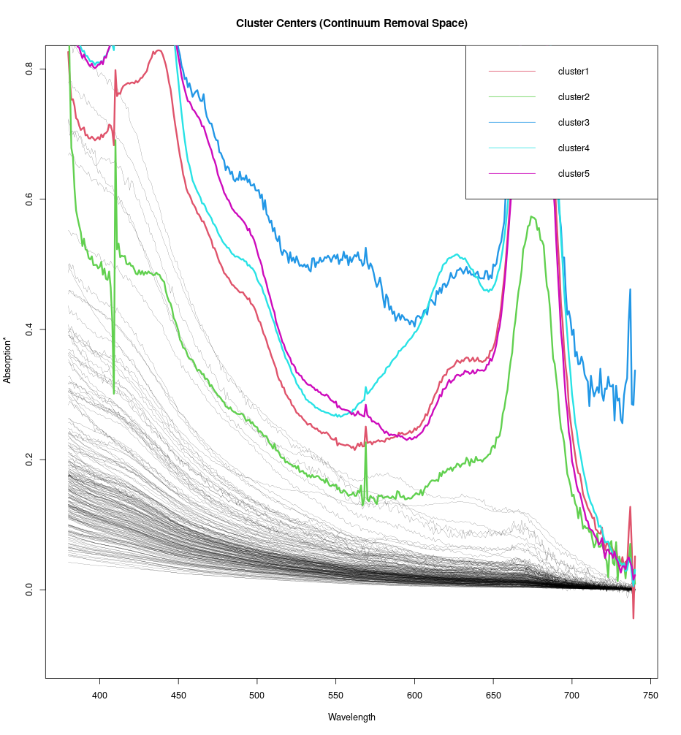
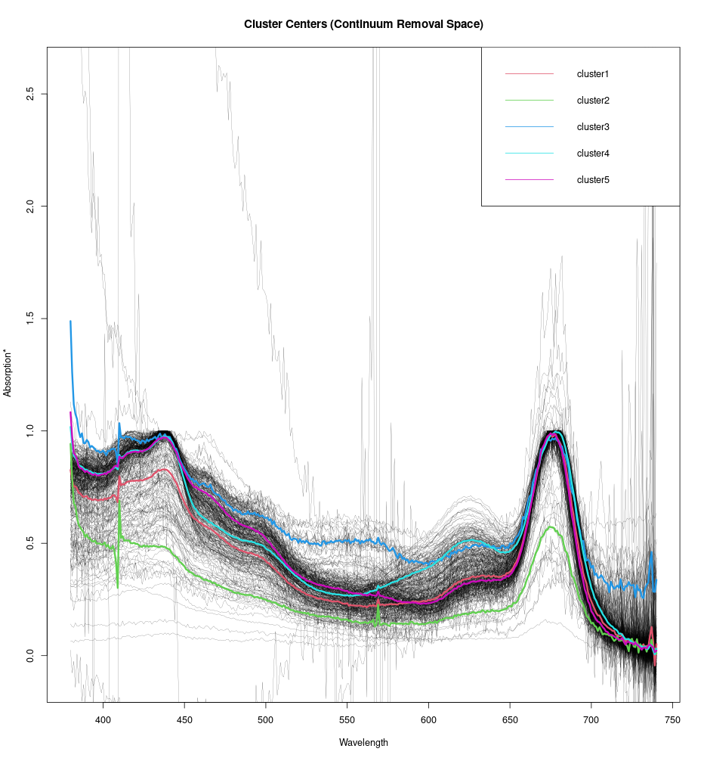
Clustering
Can’t undo continuum removal after clustering to get cluster centers, but a technique like FCMdd (Fuzzy C-Medoids) may alleviate this as it chooses actual data points to base the centers

Slide 10
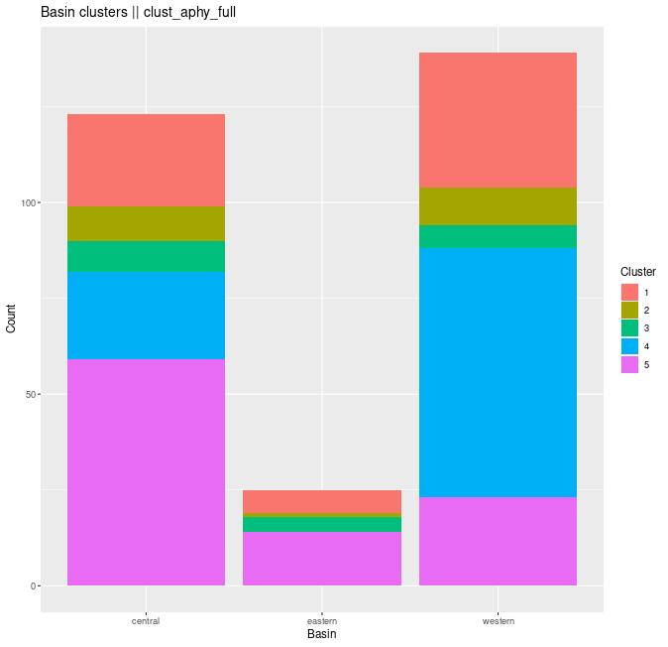
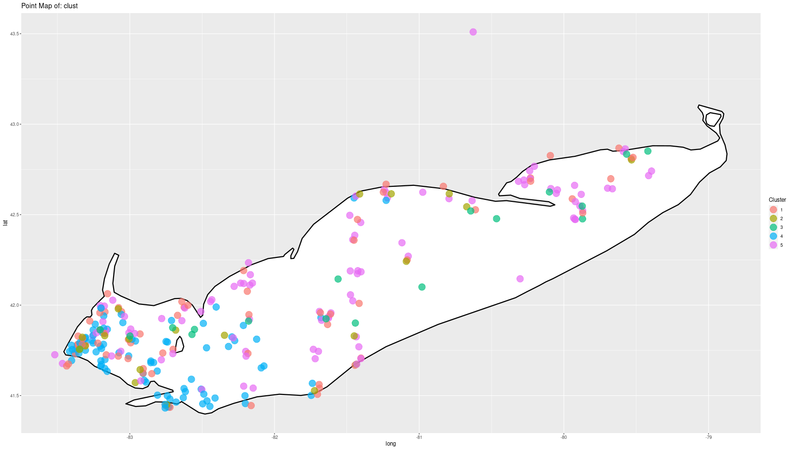
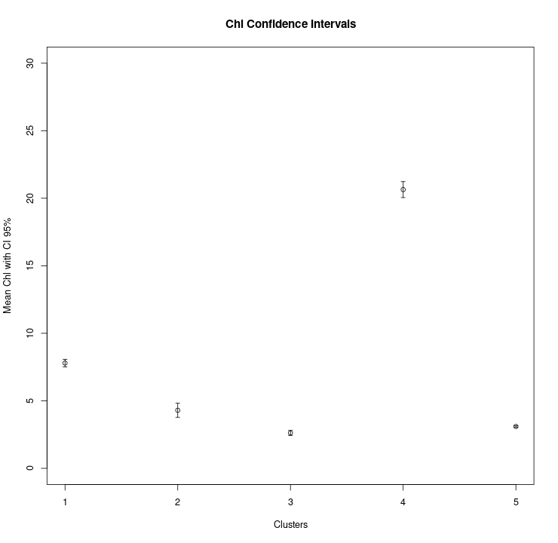
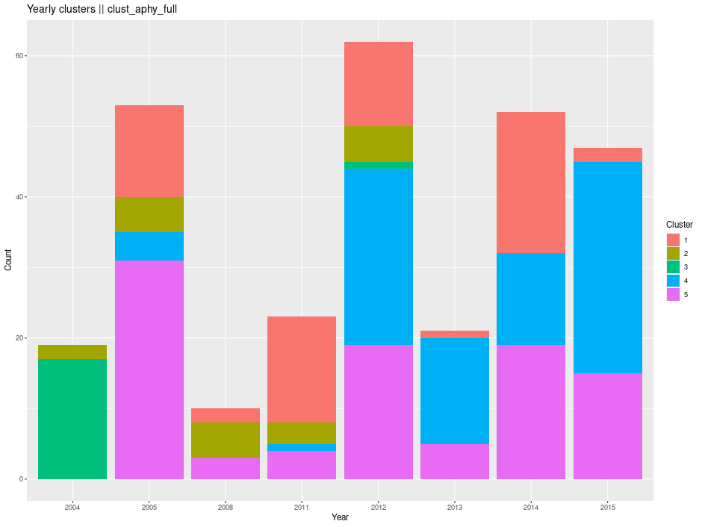
Clustering
Notes:
Future work: clustering MODIS Rrs data to see how reflectance clusters compare with the a(phy)* clusters, and the group involvement as a result

Slide 11
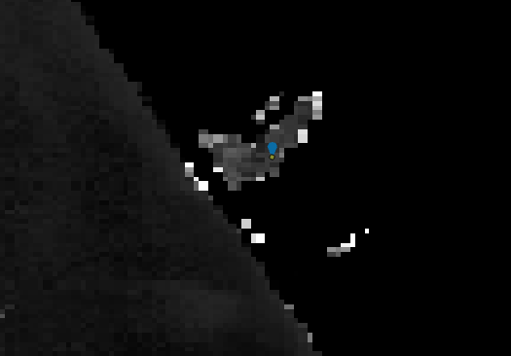
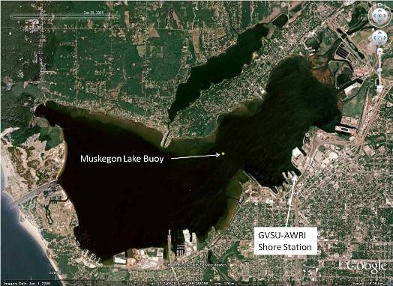
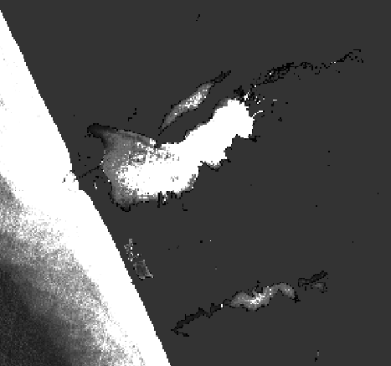
Muskegon Lake
Objectives: Evaluate and explore the application of aquatic remote sensing (Sentinel-2 MSI and Sentinel-3 OLCI) to Muskegon lake from 2019-2020 as a “test” case
Sent. 3
Sent. 2

Slide 12
Processing…
"When ecologists can read numbers like musician's hear notes, then perhaps we will hear symphony where we previously only sensed cacophony."
~Victor Smetacek, 1986 Ophilia
Pull cloud free products and good swaths
Model Build and Compute Statistics in ArcGIS
ESA Copernicus
ArcGIS
SNAP
R
Process in SNAP using Case 2 regional Coast Colour (C2RCC) while also subsetting, resampling, and ‘band-mathing’ products
Extract and perform Statistical Analysis and visualizations in R
Notes:
Mention: first time using ArcGIS, there was definitely a lot of time spent looking things up on help forums

Slide 13
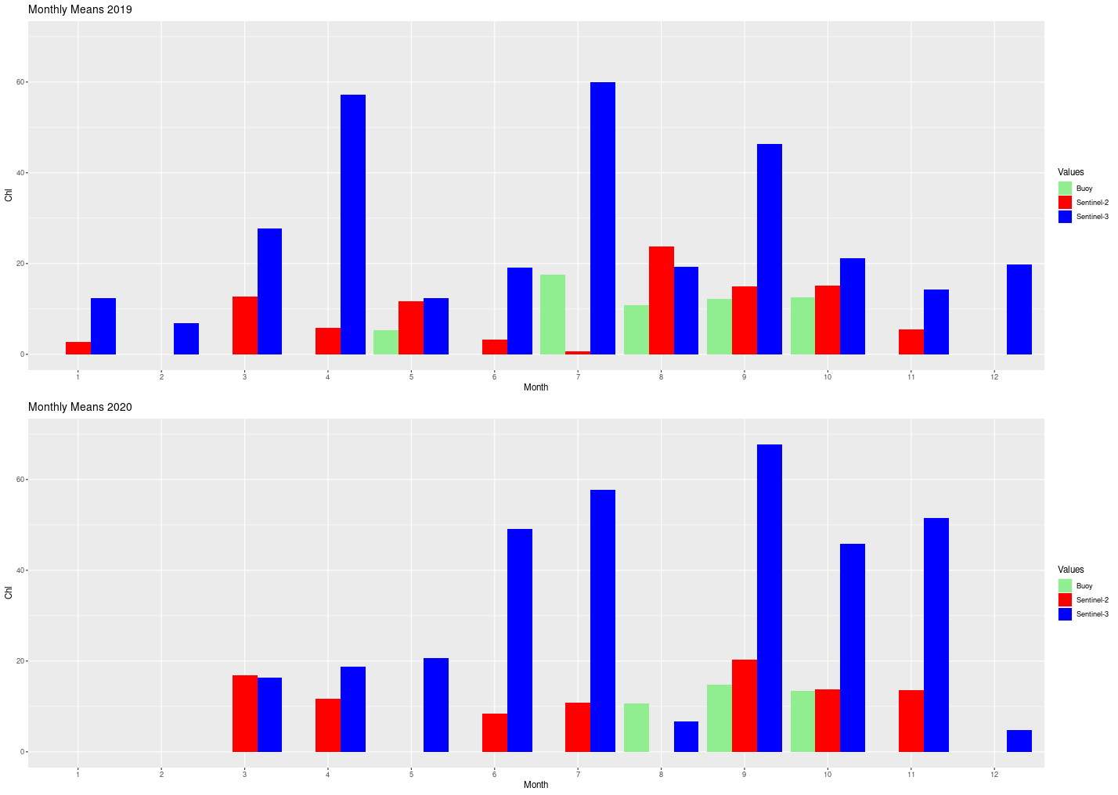
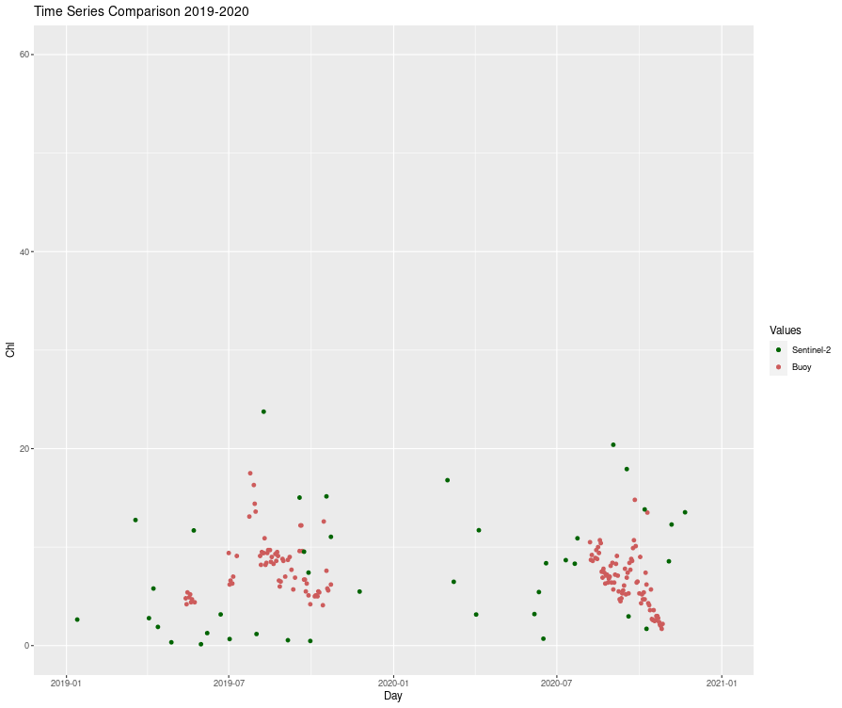
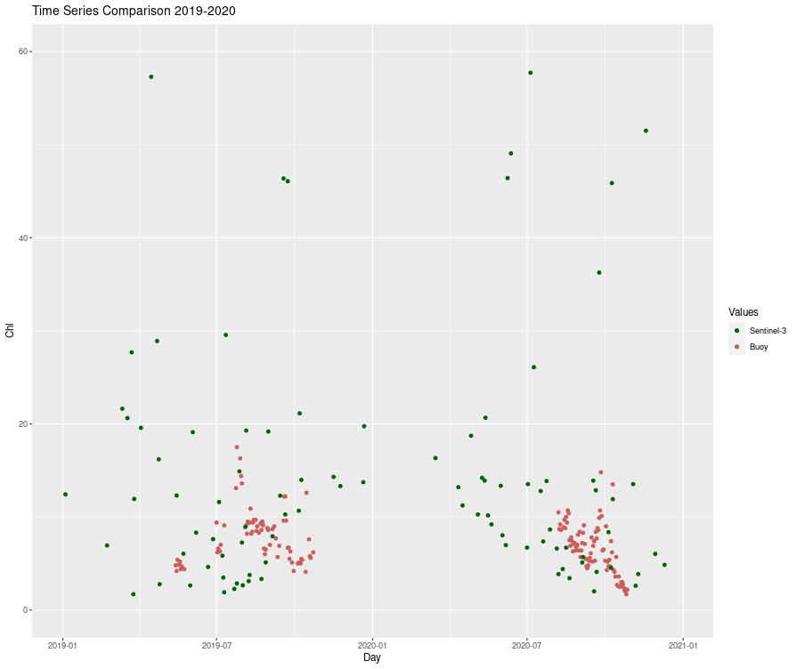
Muskegon Lake
Analysis:
Temporal: seasons, years, months, julian days, and hours
Spatial: basins (east and west)
Statistical comparisons: Accuracy of RS to Buoy
Other: Frequency occurrence, stack
mean plots, etc…

Slide 14
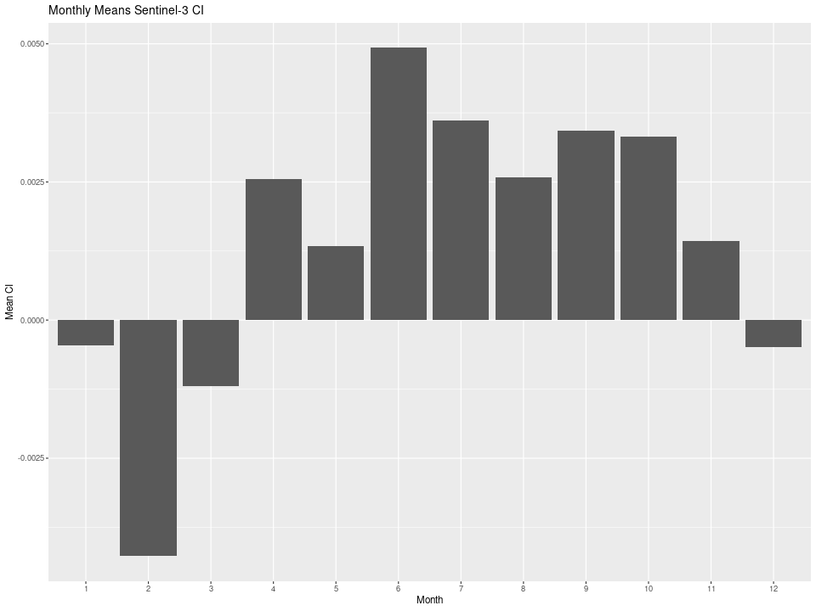
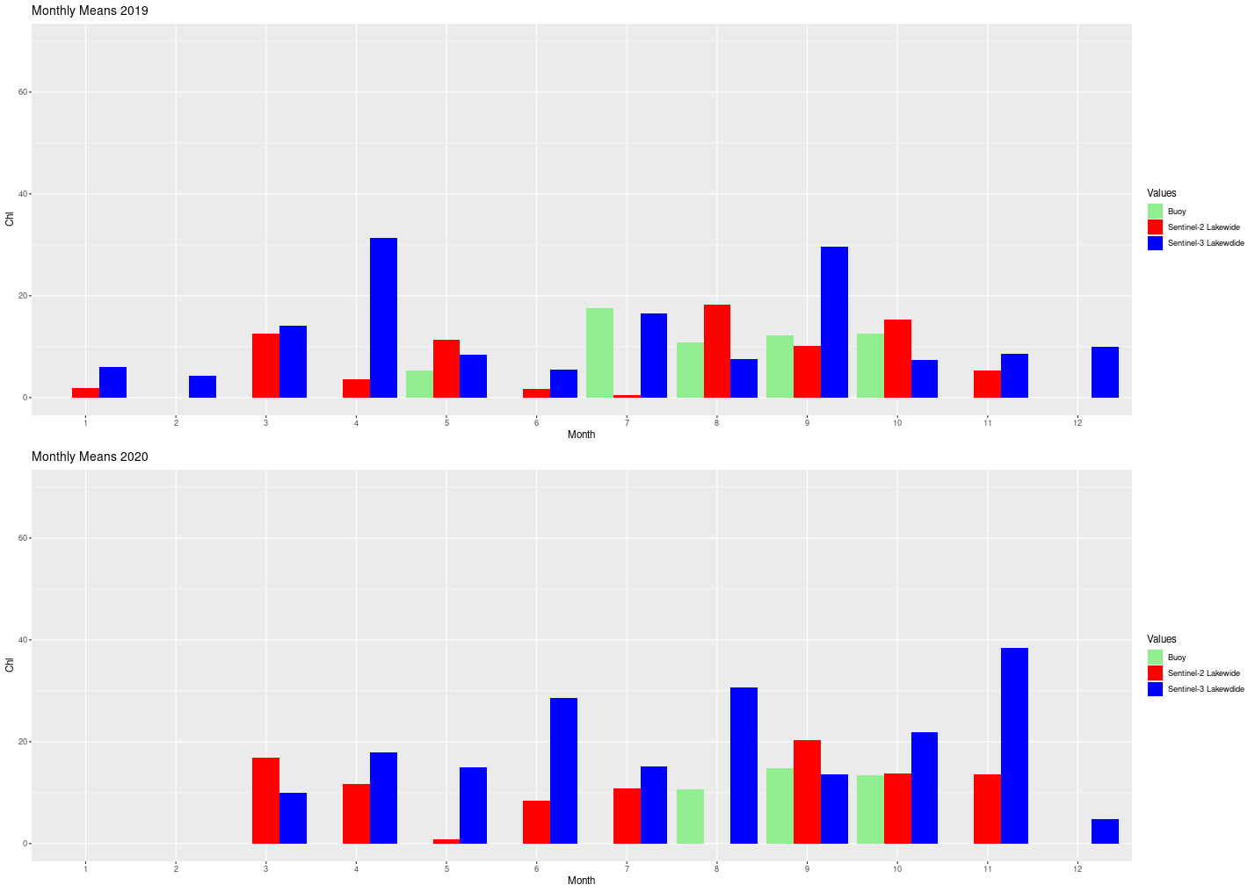
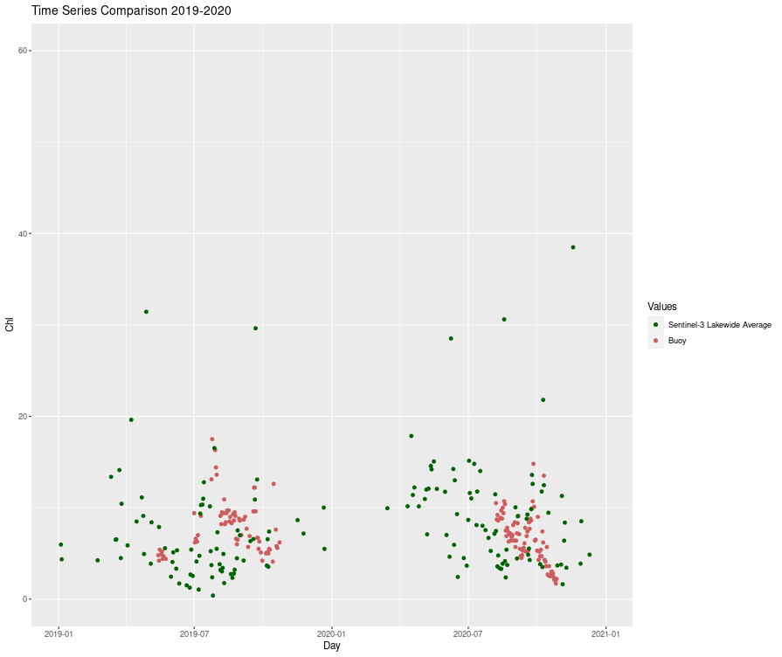
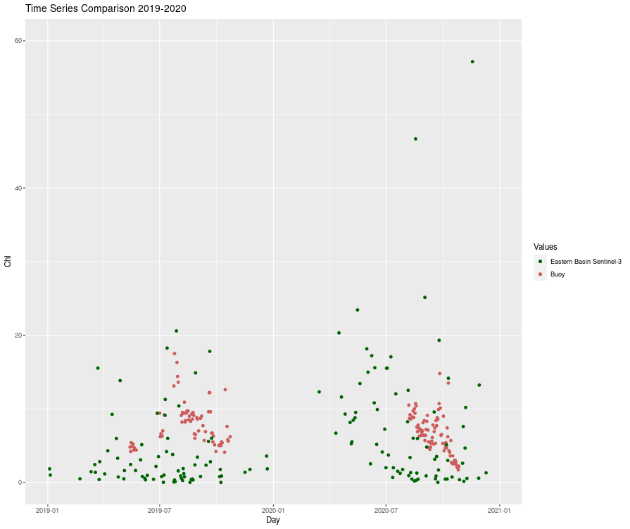
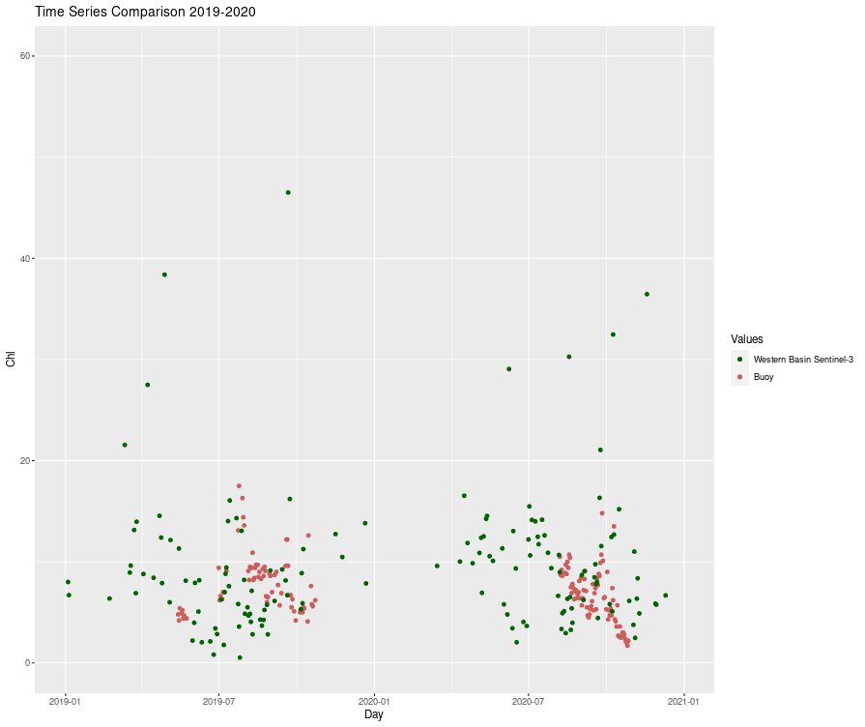
Muskegon Lake
Notes:
sentinel-3 lakeside and basins are a lot more in tow with the buoy results, cyanobacteria-index peaks right where you would expect in the summer months, and shows june to be the month with highest CI indicating most blooms then

Slide 15
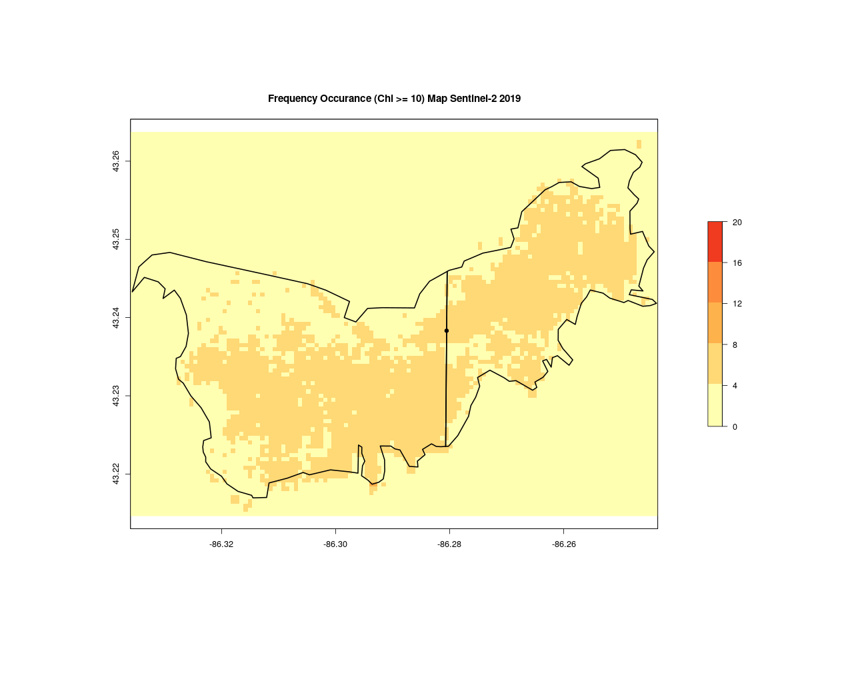
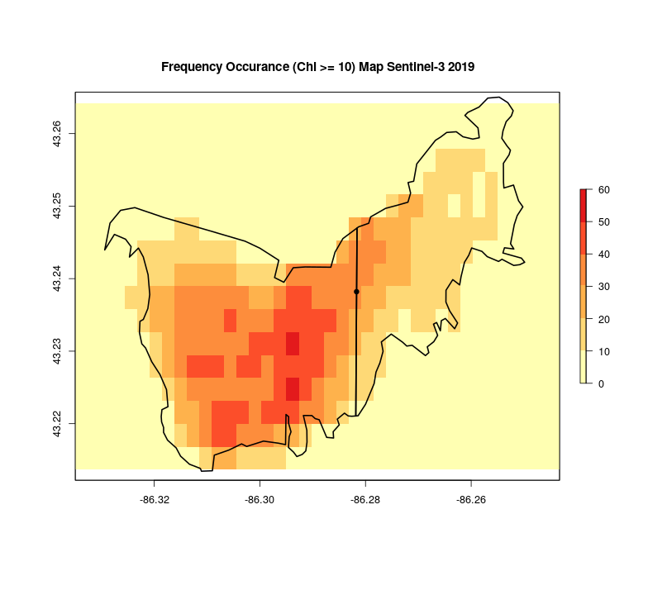
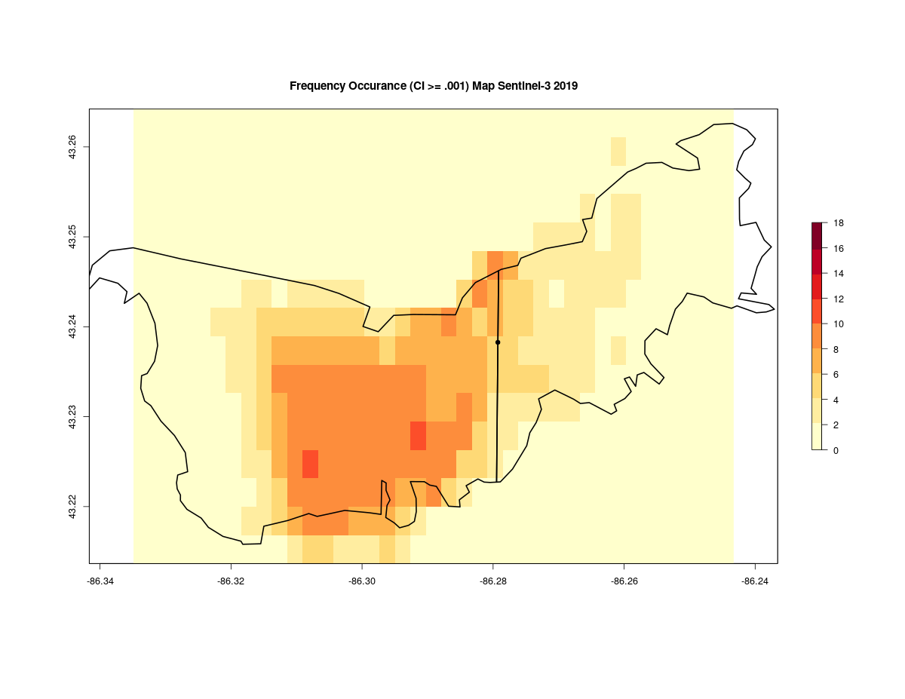
Muskegon Lake
Cyanobacteria Index (CI)
=
Indicator of Harmful Algal Bloom (HABs)
Notes:
Frequency occurrence plots; set some threshold which bins values into even or non-event, count the number of events in a given time interval, reveals geographical patterns. Cyanobacteria index. Sentinel-3 again overestimating Chl in western basin, and backs up CI frequency map

Slide 16
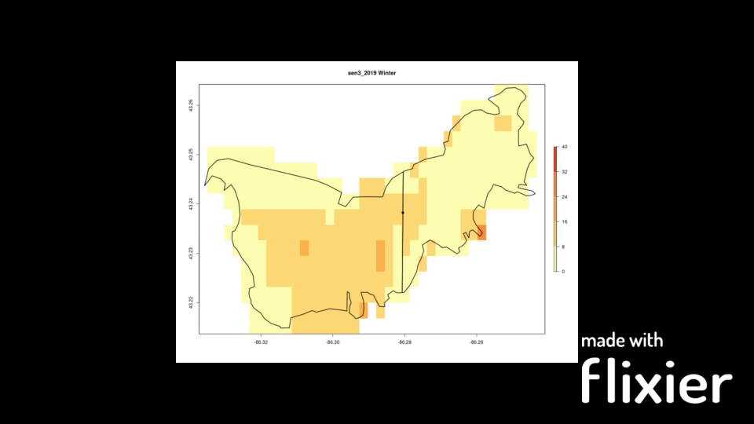
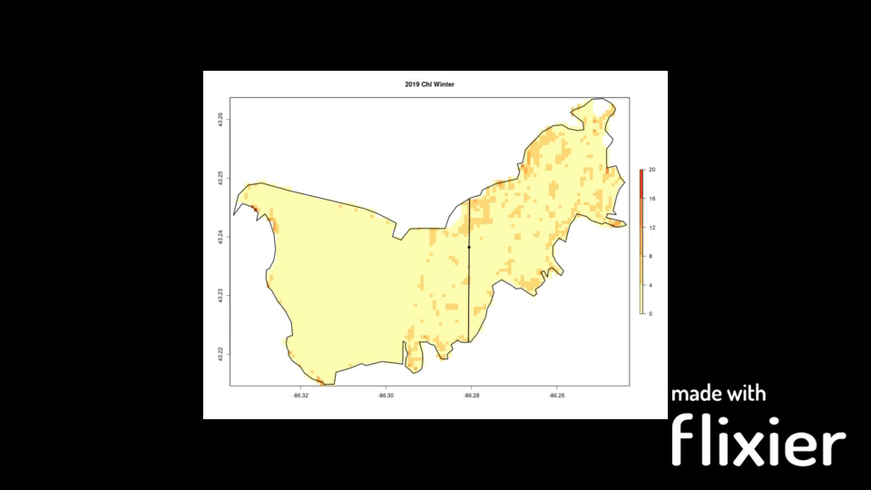
Muskegon Lake - Stacked means (Chl)
Sentinel-3
Sentinel-2
Notes:
Some other things I made are stacked mean plots which show mean chl at a given season and shows seasonal trends for muskegon lake, because of how grainy sentinel-3 is you can see sometimes on the border high values which are a result of taking in some land

Slide 17
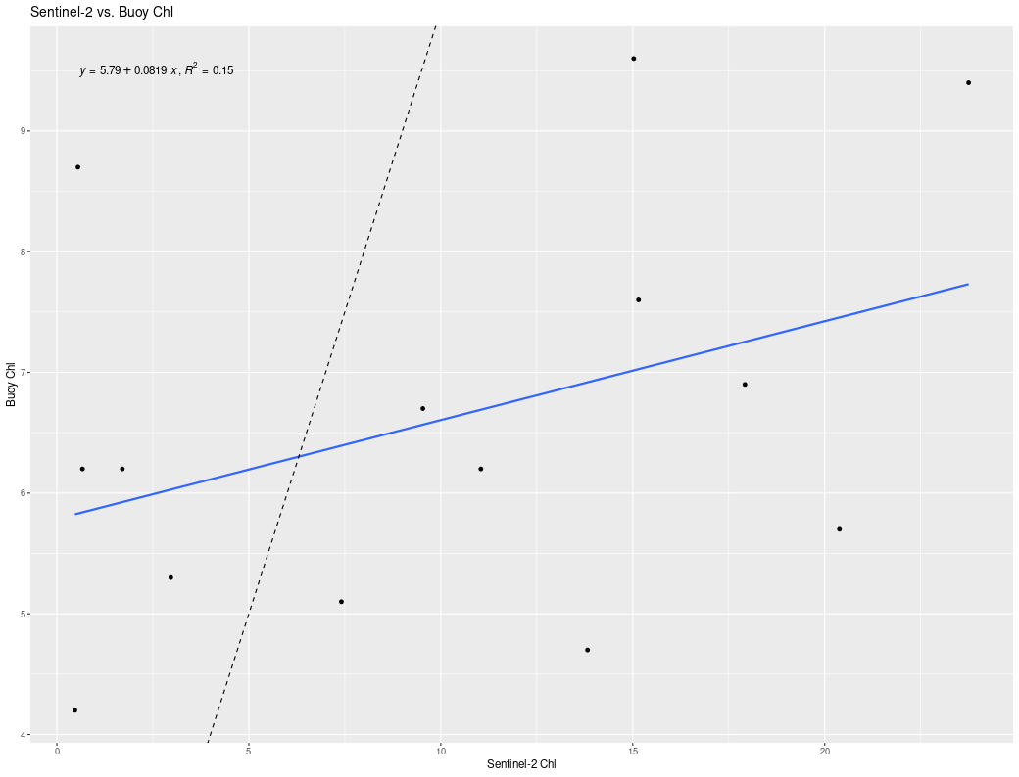
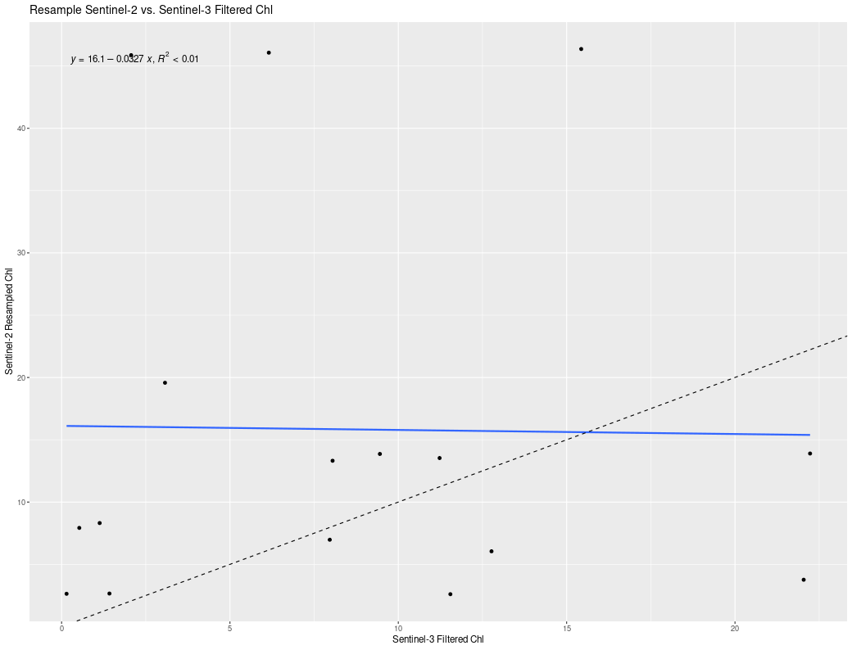
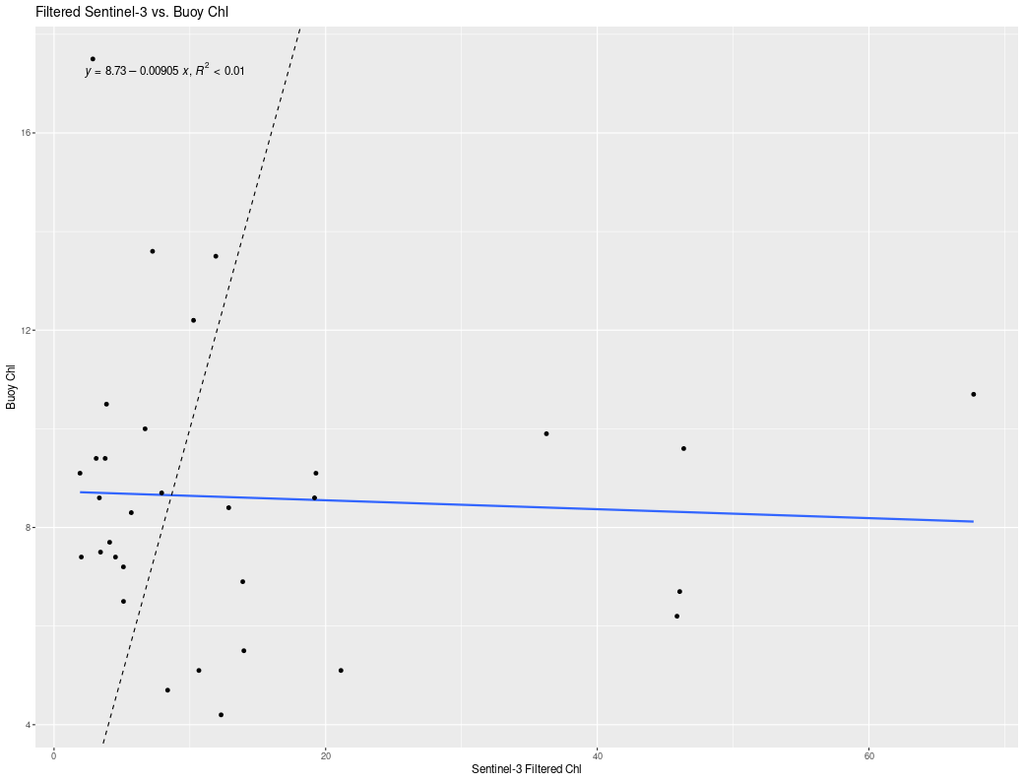
Muskegon Lake
Overall:
RS not particularly accurate

Slide 18

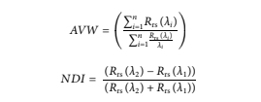
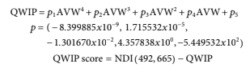
QWIP Score (Quality Water Index Polynomial)
Why care? Easy to implement in ocean color processing chains to quantify and flag questionable spectra for analysis
Apparent Visible Wavelength (AVW): one-dimensional geophysical metric of color
Normalized Difference Index (NDI): used on red (665 nm) and green (492 nm) wavelengths
Notes:
Implementing the methods of this paper on MTRI data to see how it turns out and how valid it is.
NDI wavelengths choosen because it balances and maximizes the encompassment of the three water types: green, blue, and brown
Rrs are parameters with uncertainties that are often quite challenging to quantify under a single method

Slide 19
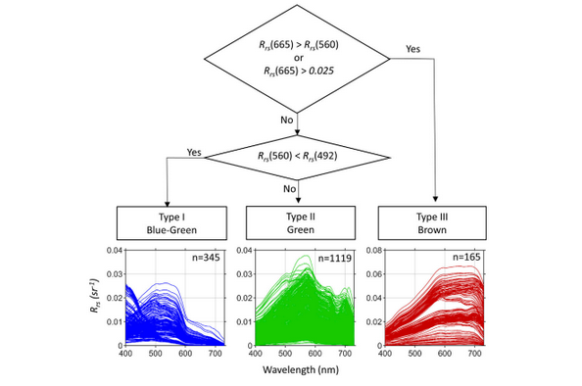
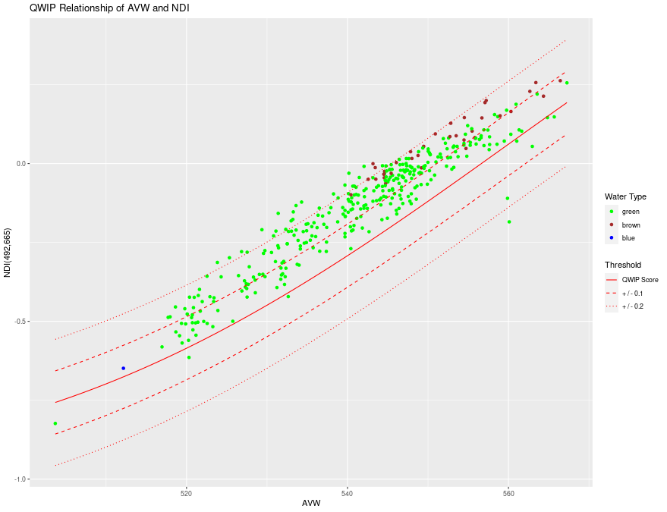
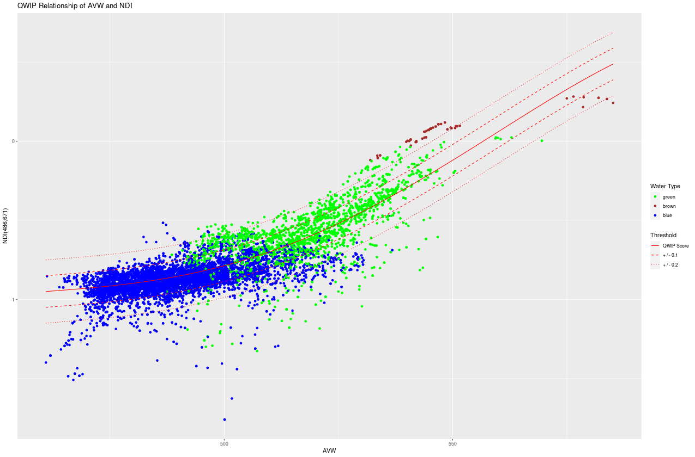
QWIP Scores
| QWIP Score | >= 0.2 Flagged
Interesting Characteristics of QWIP:
Low QWIP ~ incorrect removal surface reflected skylight
Low QWIP ~ optically shallow water
Notes:
Top image: hyperspectral in-situ data from hypergun as one would expect there's a lot of green water from lake erie
bottom image: multispectral data from VIIRS from great lakes
Can be used for both multispectral (with some calculation and conversion) and hyperspectral data

Slide 20
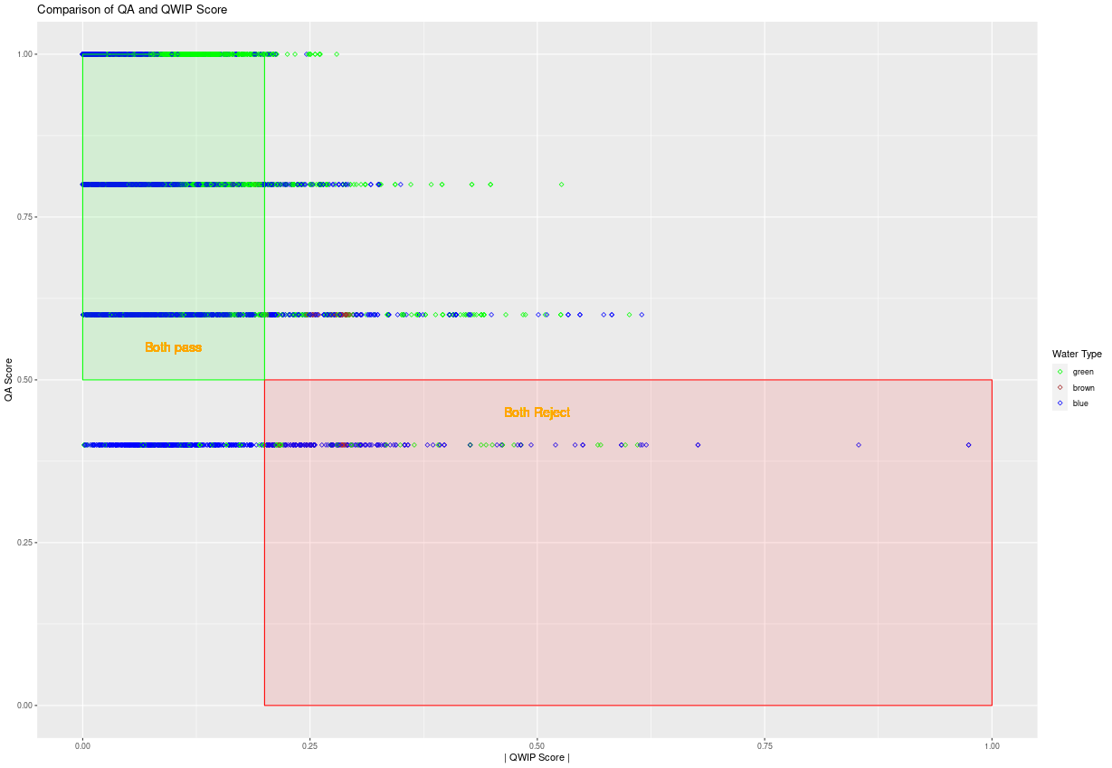
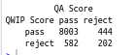
QWIP Scores
The Wei or quality assurance (QA) system matches spectra to 23 optical water types from purple blue to yellow and assigns a metric [0,1].
QA Score < 0.5 flagged
The money question?
Notes:
A well implement quality score is the QA or Wei score, values closer to 1 generally indicate higher quality
Compare the pass/reject of methods to understand the strengths and weaknesses of the quality scores
Benefit of QWIP is its continuous range while QA usually happens at discrete intervals (every 0.2)

Slide 21
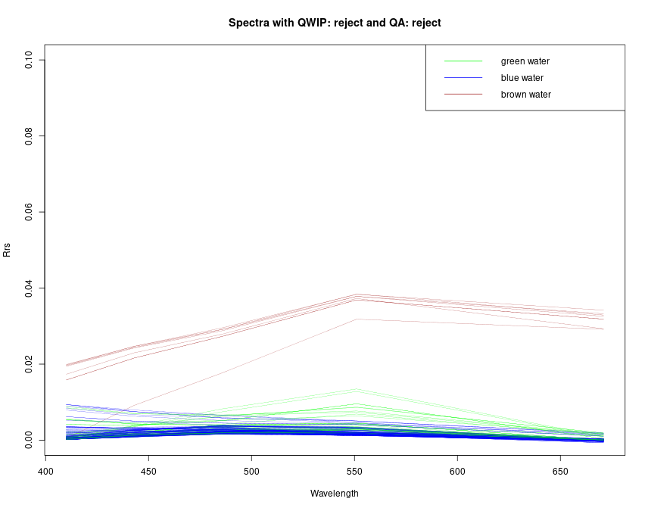
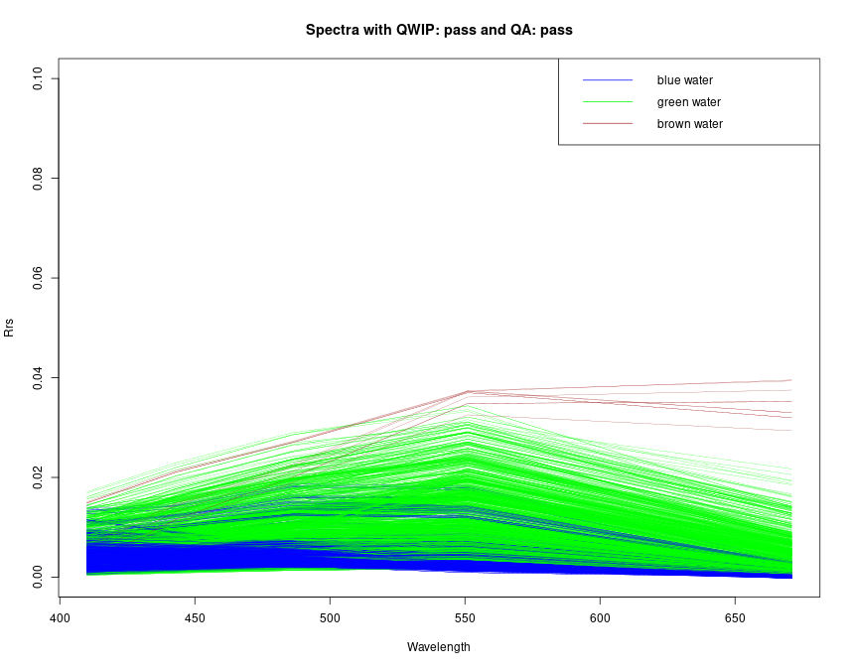
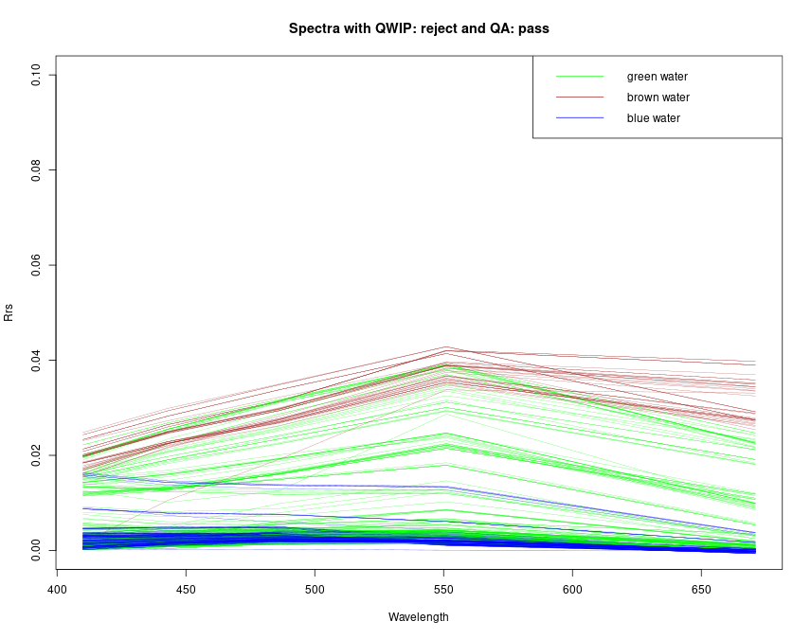
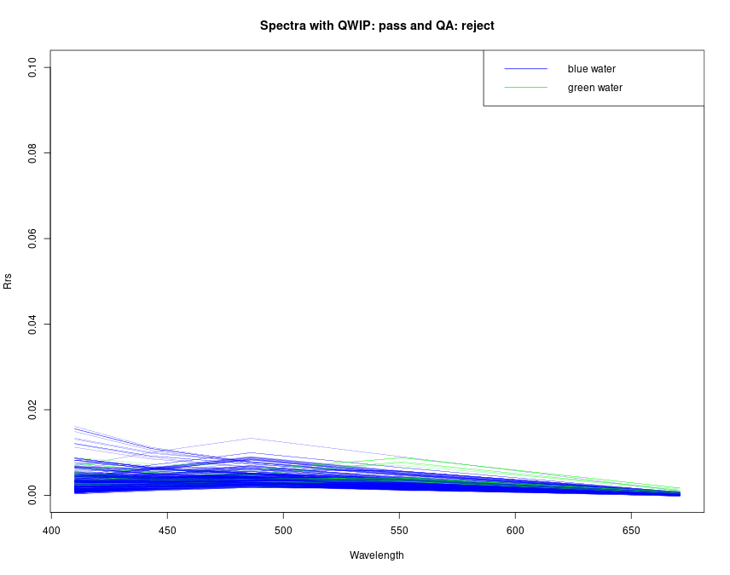
QWIP Scores
Notes:
Lots of blue water fails QA, but passes QWIP.
Various types of water are rejected by qwip, but pass QA. These could be samples that don’t belong to a simple green/blue/brown water type but QA matches to different types as it ranges (from purple-brown to yellow). QA may do better on more outlying color type water. May be optically shallow which is why qwip rejects since the types are all water types.
QA rejects blue water found in lake michigan and huron which QWIP passes.

Slide 22
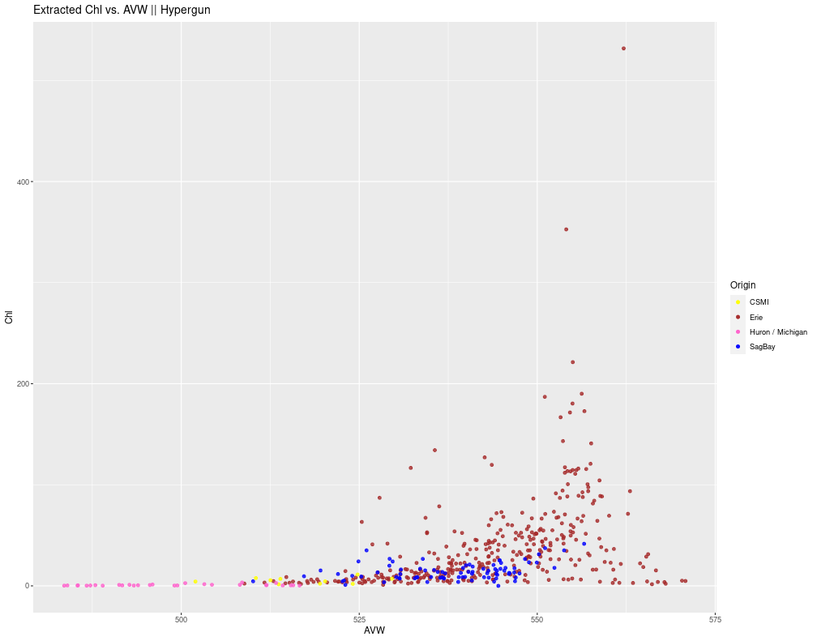
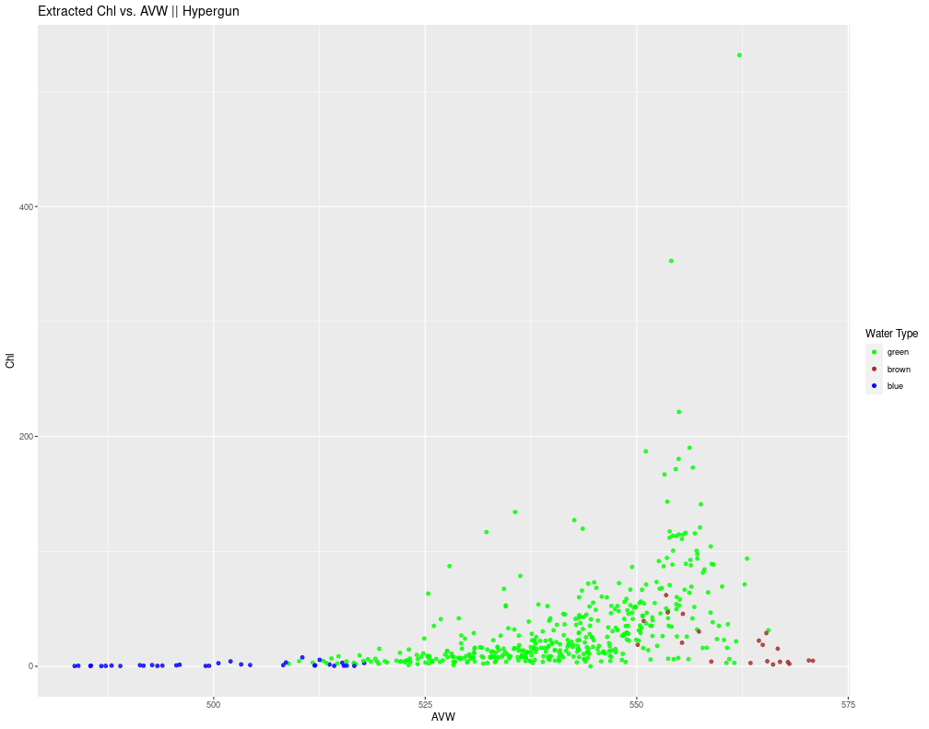
QWIP Scores - AVW
AVW really is just a measure of the dominant color of the water
For blue and brown water, as AVW increases there's not a significant trend with Chl
For green water, an obvious relationship can be visualized between AVW and Chl

Slide 23
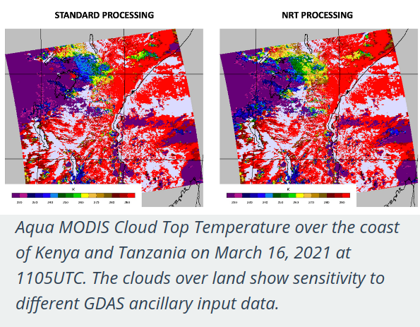
VIIRS NRT & SQ
Objective: Investigate the extent of differences in near real time (NRT) and science quality (SQ) VIIRS (everyday temporal resolution) products from JPSS1 and SNPP
Major difference: latency and ancillary data used
Notes:
NRT released hours after satellite pass, SQ can be a few days.
ancillary data may be from past days or of not high quality.
If theres not real significant difference between NRT and SQ, then just NRT since it can be rapidly incorporated into models.

Slide 24
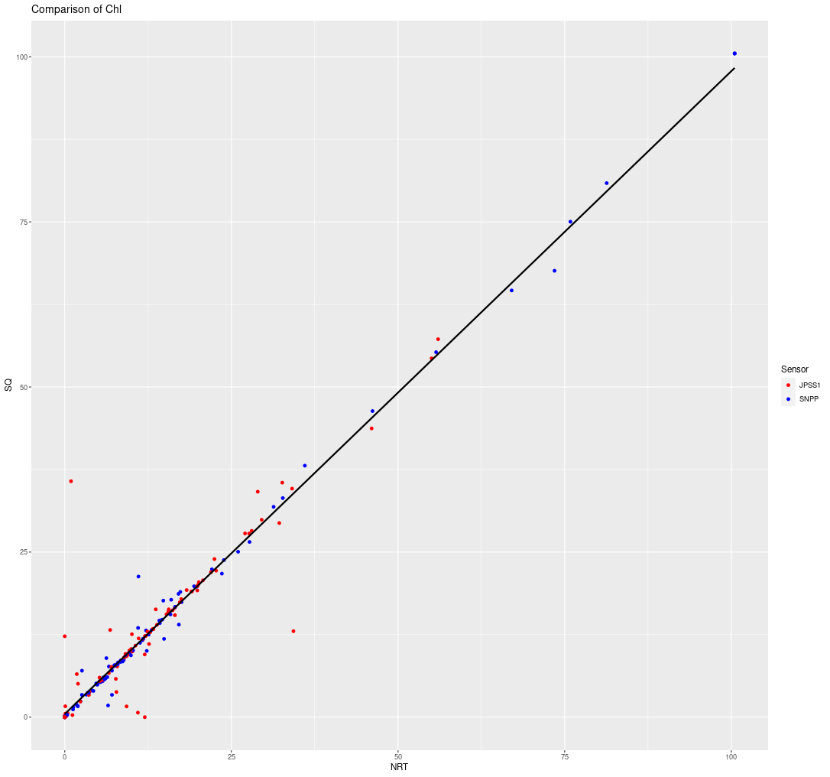
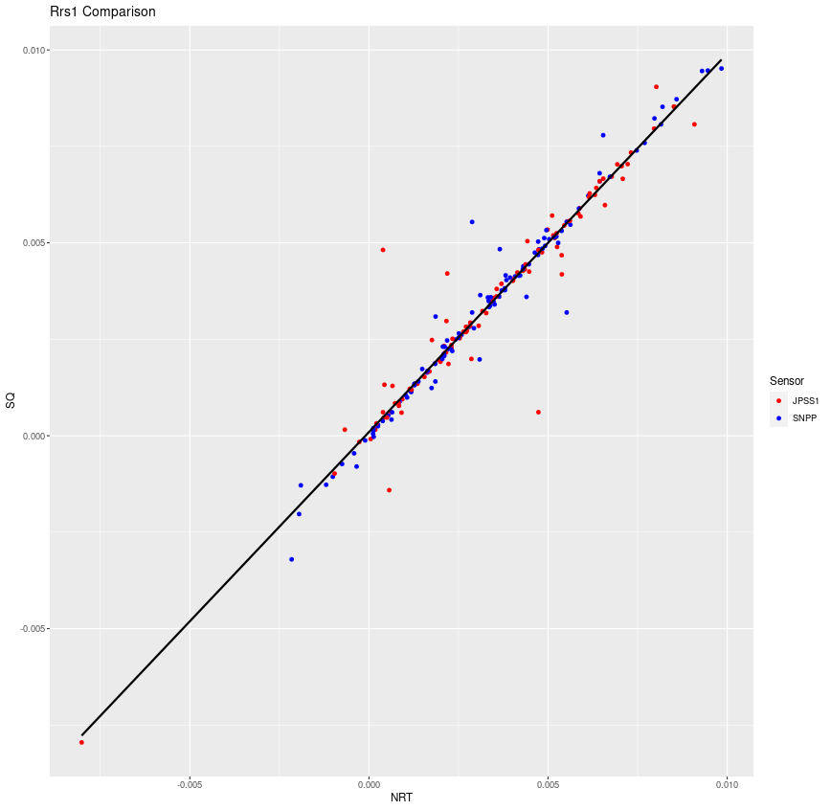
VIIRS NRT & SQ
Chl retrievals and Reflectance (410) show very good relationship at Lake Erie Stations
What about elsewhere? different optical environment? spatial variation?
Notes:
After a long time of processing using CPA color algorithm, have Chl and a 5 bands of spectral data

Slide 25
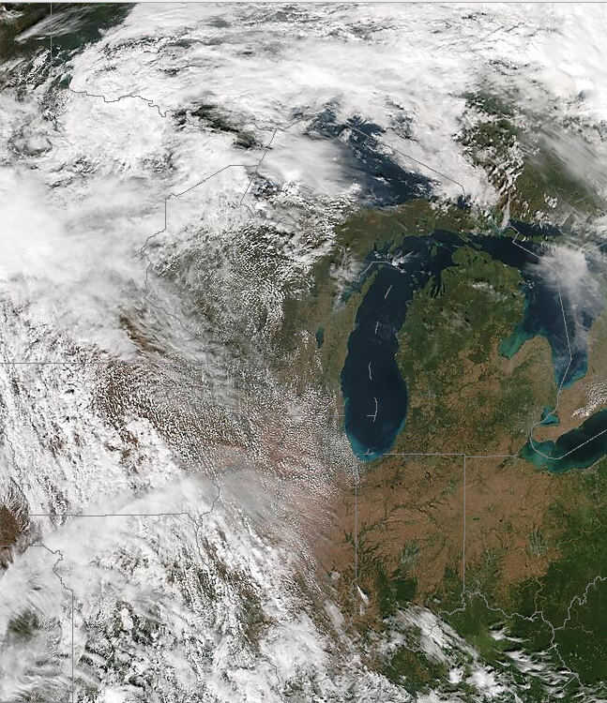
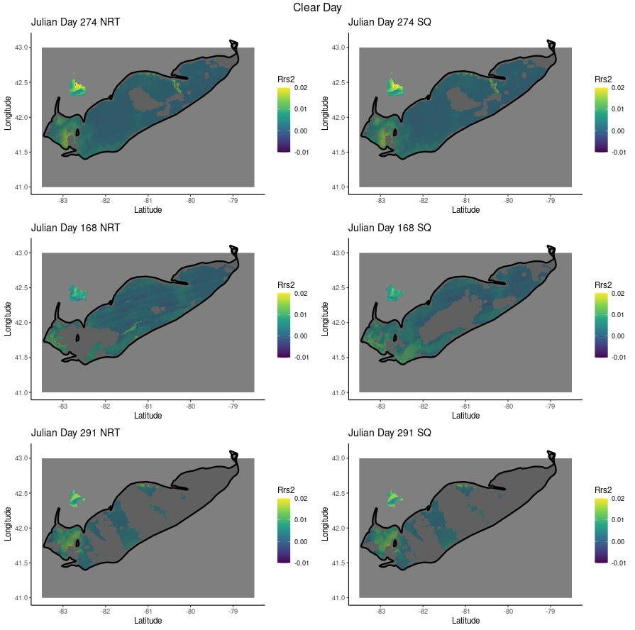
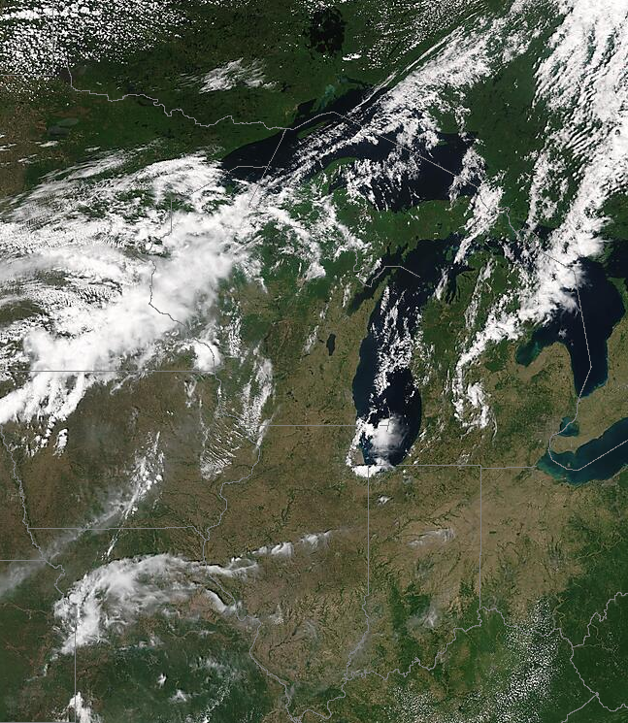
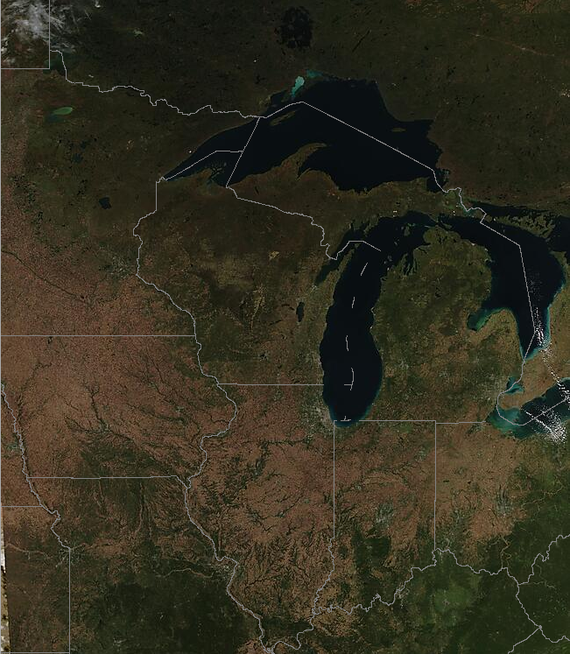
Spatial Variation (relatively clear)
Notes:
Discrepancies in geographical coverage

Slide 26




Spatial Variation (cloudy)
Notes:
ultimately not too much variation between NRT and SQ regardless of cloud conditions

Slide 27

Lake Michigan Optics
Hypothesis: Lake Michigan (more clear) may be more impacted due to aerosol correction in clearer (darker) waters being larger as opposed to Lake Erie (less clear).
Notes:
Ultimately doesn’t change all so much

Slide 28

Toxins & Scum
Objective: Lots of models exists to detect harmful algal blooms (HABs), but generally there is not a remote sensing method of deriving toxin concentrations from these HABs
Lake Erie is full of Cyanobacteria which produce Microcystin, a human carcinogen and liver toxin
Notes:
-Toxin concentrations are generated from in-situ water samples
-time consuming and it costs money

Slide 29

Toxins & Scum
Two types of toxins: Particulate Microcystin - unable to pass through filter
Dissolved Microcystin - passes through filter (more important)
Try to predict with scum index (SSI) which is essentially NDVI.
Higher SSI (close to 1) indicate green/healthy vegetation
Pixel = scum if SSI > 0
Notes:
he scum index is really just the NDVI, and we call a pixel scum if the NDVI/SSI is positive. For normal vegetation, NDVI gets closer to 1 when it is greener/healthier. So we basically want to see if more intense/toxic scums also retrieve NDVI closer to 1. If so, then we could maybe find some sort of relationship between NDVI from remote sensing and toxicity.

Slide 30


Toxins & Scum - Microcystin
NDVI/SSI isn’t really the best indicator for dissolved microcystin,
but stronger relationship for particulate microcystin
Limitations: data (few scum samples), spatial resolution, lifecycle
Notes:
data need a lot of scum samples to establish a relationship (need high dissolved microcystin to see the variation in NDVI)
spatial resolution a scum/bloom may be very small compared to the spatial resolution swath
lifecycle: particulate microcystin is in the green-blue cyanobacteria (deriving NDVI from visible light), particulate breaks down and is transformed to dissolved when cyanobacteria breaks down (visible light goes down)
-Discrepancy between detecting the bloom using remote sensing and the respective delay until the cyanobacteria breaks down and releases the microcystine

Slide 31

Toxins & Scum - Microcystin
In-situ “scum” samples don’t differ significantly from normal sample for dissolved microcystin, but vary significantly for particulate microcystin concentrations.

Slide 32

Toxins & Scum - Microcystin
If particulate is known, is there a way to generate dissolved concentrations?
Not really, high seasonal variation and micro-temporal variation
Relationship is complex
Notes:
Future work?: Multimodality model.
SSI quantify amount of scum
scum to particulate microcystin
particulate microcystin + ancillary data (buoy, time when bloom dies) can estimate relative dissolved concentrations of microcystin

Slide 33



Toxins & Scum - Microcystin
Well if can’t predict dissolved microcystin yet, try to get a better grasp on particulate microcystin.
(Red = 669.52 & NIR = 802.54)
Experiment with NIR bands (larger variation in Rrs as wavelength increases).
NIR:
719.54
NIR:
699.55
Notes:
699.55 creates a separable threshold at NDVI 0, where particulate concentration is above the dissolved microcystin health advisor at 1 ug/L which pairs well with how MTRI uses SSI/NDVI to character pixels as scum/normal by NDVI. Essentially, characterize as scum and whether the colony is toxic or not (note this isn’t released toxins, just toxins stored in the cyanobacteria cells).

Slide 34
Learning
Programming
Improved R
Bash & Linux
ArcGIS
Task Automation and Batch loading
Miscellaneous
Remote sensing
Water Science (ecology, geography, environment, remote sensing specifics)

Slide 35


Field Work ft. Luscious Green Waters of Erie
Field Work
Western Basin Lake Erie
Saginaw Bay
Equipment:
HyperPro
HyperGun
Fluoroprobe
IOP Cage

Slide 36

Questions
Thanks for listening
Questions?

